Slide 1
Algorithms: Dynamic Programming Elements of DP Computing Fibonacci Numbers
Course Code: CSE-2218
Data Structure and Algorithms II Lab
Lec Saifur Rahman
Email: saifur@cse.uiu.ac.bd
Mobile: +8801303529289

Slide 2
Algorithmic Paradigms
Divide-and-conquer: Break up a problem into disjoint (non-overlapping) sub-problems, solve the subproblems recursively, and then combine their solutions to form a solution to the original problem. Brand-new subproblems are generated at each step of the recursion.
Greedy: Build up a global solution incrementally, myopically by optimizing some local criterion.
Dynamic programming: Break up a problem into a series of overlapping sub-problems, and build solutions to larger and larger sub-problems. Typically, the same subproblems are generated repeatedly when a recursive algorithm is run.

Slide 3
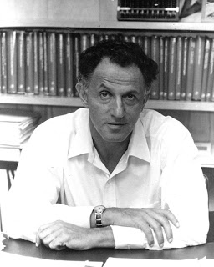
Dynamic Programming History
Bellman [1950s] Pioneered the systematic study of dynamic programming
Etymology:
Dynamic programming = planning over time
The Secretary of Defense was hostile to mathematical research.
Bellman sought an impressive name to avoid confrontation
Richard Bellman

Slide 4
Dynamic Programming Applications
Areas:
Bioinformatics
Control theory
Information theory
Operations research
Computer science: theory, graphics, AI, compilers, systems, …

Slide 5
Properties of a Problems that can be Solved with Dynamic Programming
Simple Subproblems
We should be able to break the original problem to smaller subproblems that have the same structure
Optimal Substructure of the Problems
The solution to the problem must be a composition of subproblem solution
Subproblem Overlap
Optimal subproblems to unrelated problems can contain subproblems in common
No. of Subproblems is Small
The total number of distinct subproblems is a polynomial in the input size.

Slide 6
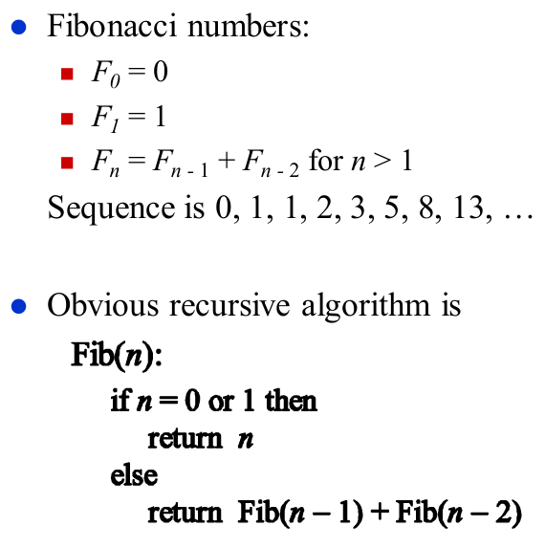
Computer Fibonacci Numbers

Slide 7
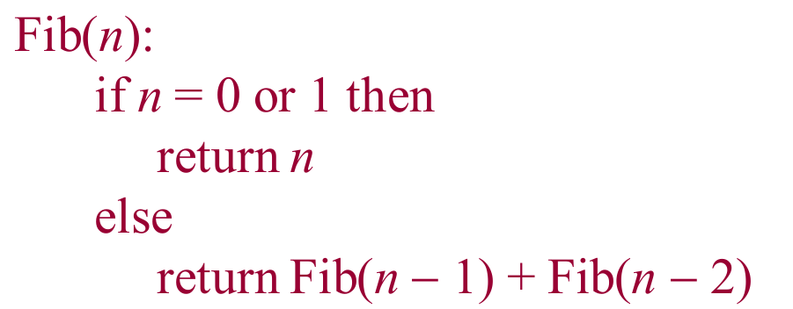
Recursion Tree for Fib(5)
f(5)
f(4)
f(3)
f(3)
f(2)
f(2)
f(1)
f(2)
f(1)
f(1)
f(0)
f(1)
f(0)
f(1)
f(0)
Optimal Substructure Property?
Overlapping Sub problems

Slide 8
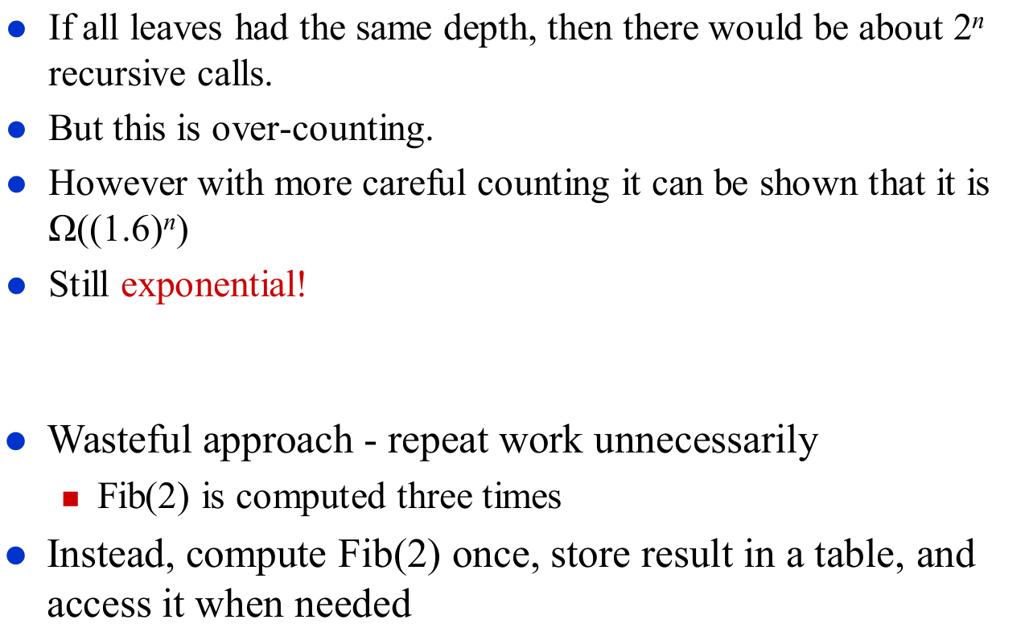
How Many Recursive Calls?

Slide 9
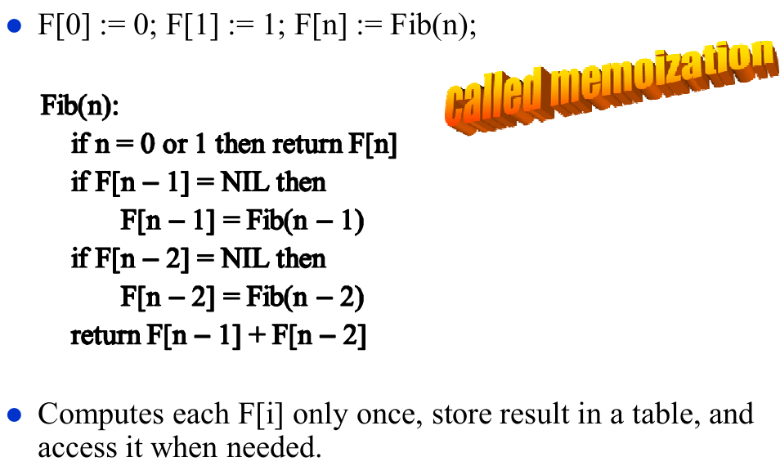
More Efficient Recursive Algorithm

Slide 10
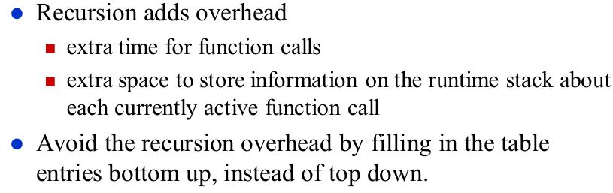
Get Rid of the Recursion

Slide 11
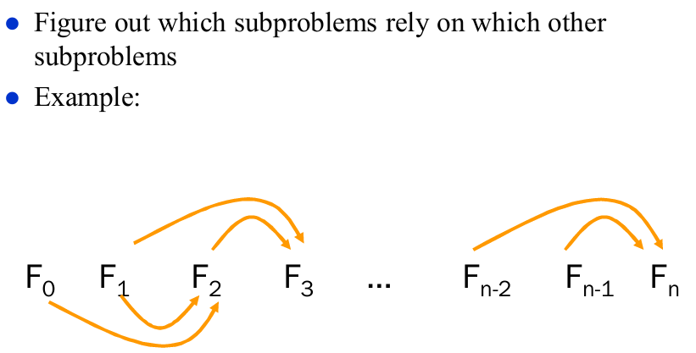
Subproblem Dependencies

Slide 12
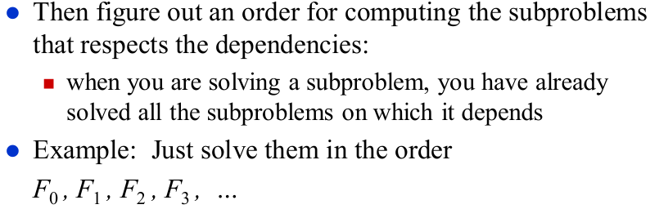
Order for computing Subproblems

Slide 13
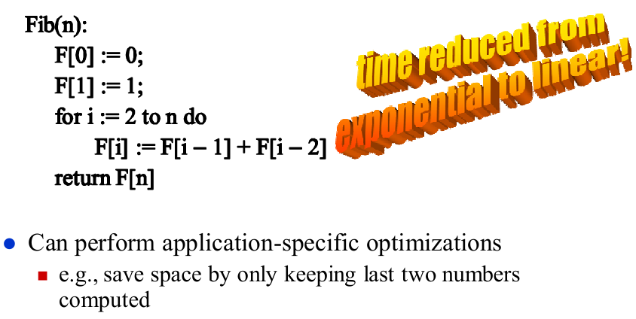
DP Solution for Fibonacci

